Slide 1
ECE 322L
Electronics 2
04/9/20 - Lecture 20
Power considerations

Slide 2
Overview
Lecture 20:
Electrical power (Review)
Power gain
Power dissipation
Power efficiency and maximum undistorted power (Neamen 6.10, S&S 1.4.4-1.4.6, Handout on UNM-Learn)
4/9/2020

Slide 3
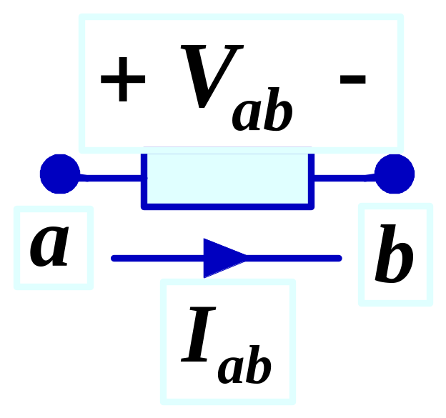
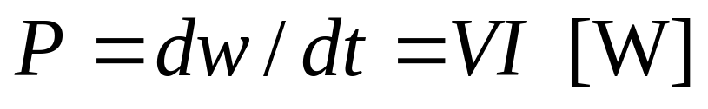
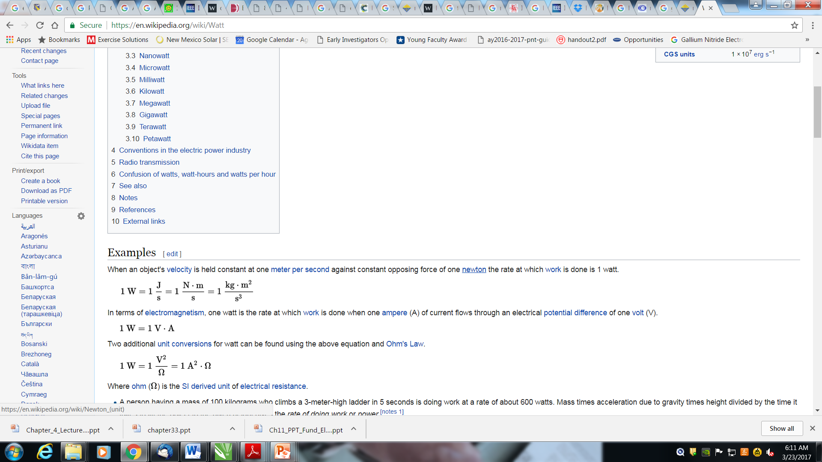
Electrical Power (Review)
Electrical power is the rate at which electrical energy is supplied or received by a component.
One watt of power is required to transfer one Joule of energy (to/from a given component) in one second
One watt of power is required to drive one ampere of current against an electromotive difference of one volt.
4/9/2020

Slide 4
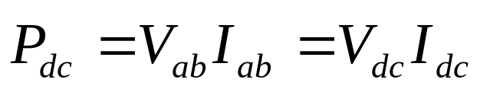
Power in DC
In DC the electrical power supplied or received by a circuit element is simply
4/9/2020

Slide 5
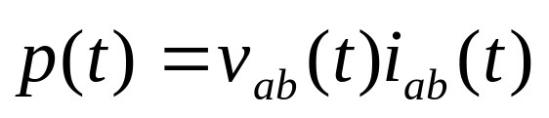
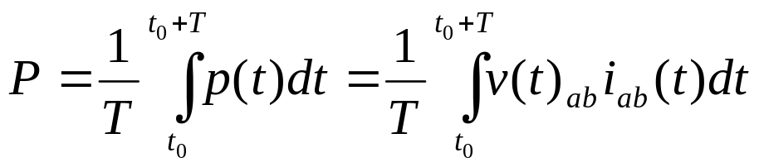
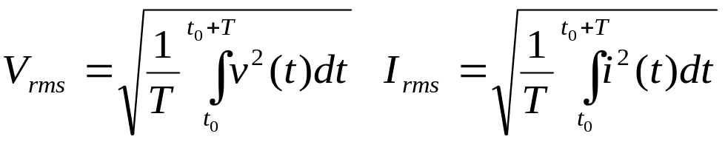
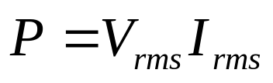
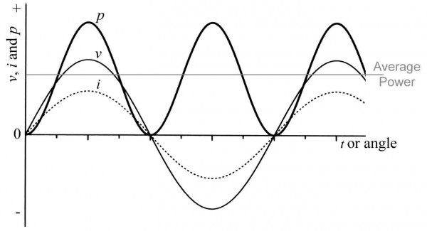
Power in AC
Instantaneous power
(Definition is valid for any ac signal)
Average power
(Definition is valid for any periodic signal with period T)
Definition of average power in terms of rms value of voltage and current
4/9/2020

Slide 6
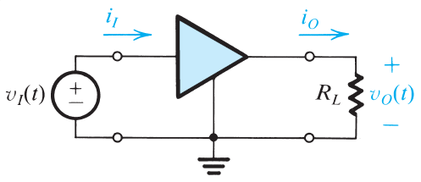
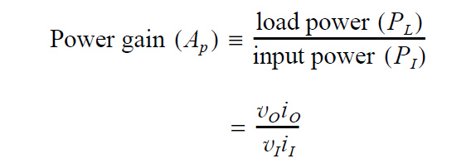

Power Gain in Amplifiers
Where is this extra power coming from? Isn’t energy supposed to be conserved?
4/9/2020

Slide 7
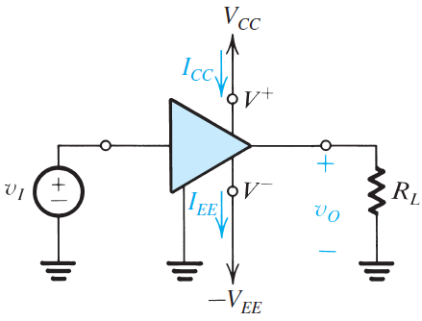
Power Gain in Amplifiers
The DC sources used to bias the transistors in the amplifier supply the “extra”
power to the load
4/9/2020

Slide 8


Power Balance Equation
Power drawn from the DC voltage/current sources (P_{dc})
Power drawn from the signal source (P_{I})
Power transferred to the load (P_{L})
Power dissipated in the circuit (by the transistor and the biasing network) (P_{dissipated})
4/9/2020

Slide 9
Power Gain in Amplifiers
-
4/9/2020

Slide 10
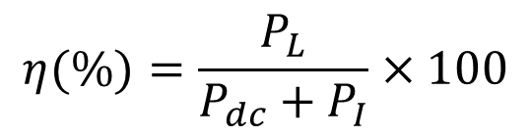

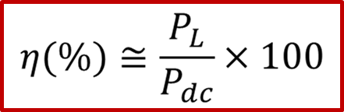
Power Efficiency
It quantifies the efficiency of the power transfer from the TWO inputs (DC power supplies and signal source) to the load
4/9/2020

Slide 11
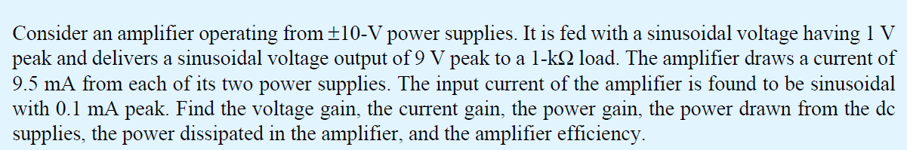
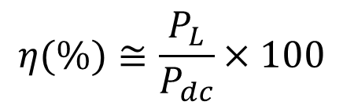
Take-home problem
4/9/2020

Slide 12
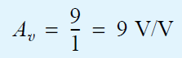
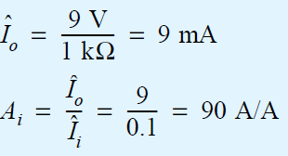
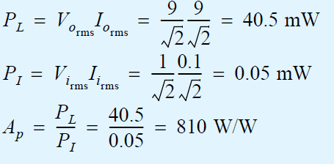
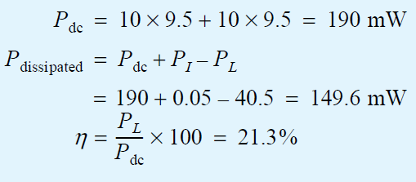
Take-home problem, solution
4/9/2020

Slide 13
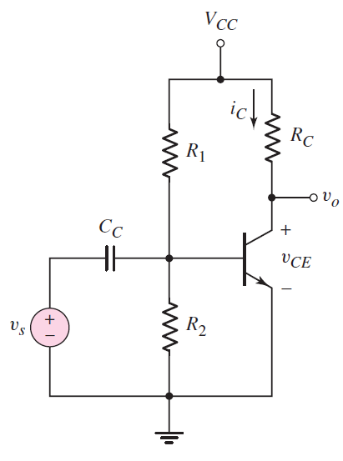
Power in Transistor Amplifiers
It is relevant to determine the various components of the power in a transistor amplifier with (v_{s}≠0) and without an applied signal (v_{s} =0).
Supplied power=
Power dissipated in the amplifier
+
Power transferred to the load
Load
P_{cc}+P_{s}=P_{Q}+P_{Bias}+P_{Rc}
P_{cc}:Power supplied by the DC voltage source (Vcc)
P_{s}: Power supplied by the ac voltage source
P_{Q}: Power dissipated by the BJT
P_{Bias}: Power dissipated by the biasing resistors
P_{Rc}: Power dissipated by the load
4/9/2020

Slide 14
Power in Transistor Amplifiers (v_{s}=0)
P_{supplied}=P_{dissipated}+P_{transferred to the load}
P_{supplied}=P_{CC}+P_{s}=P_{CC}
P_{CC}= V_{CC} I_{CC}= V_{CC}(I_{CQ}-I_{R1,R2})≈V_{CC}I_{CQ}
Load
P_{dissipated}=P_{bias}+P_{Q}
P_{Q}=I_{CQ}V_{CEQ}+I_{BQ}V_{BEQ} ≈I_{CQ}V_{CEQ}
(I_{CQ}>>I_{BQ})
P_{bias}=f(I_{BQ}), P_{Q}=f(I_{CQ}), I_{CQ}>>I_{BQ}
P_{dissipated}=P_{bias}+P_{Q}≈P_{Q}
P_{transferred to the load} =P_{RC}=I_{CQ}²R_{C}
DC only
4/9/2020

Slide 15
Power in Transistor Amplifiers (v_{s}≠0)
p_{supplied}=p_{dissipated}+p_{transferred to the load}
_{Average supplied}
_{power over one period}
_{of the input ac signal}
_{Average supplied}
_{power over one period}
_{of the input ac signal.}
Average power supplied to the load
over one period of the input ac signal.
p_{supplied}= p_{cc}+p_{s} ≈ p_{cc}
p_{cc}>>p_{s} as the input signal is small w.r. t. the DC voltage source (Vcc)
DC+AC
p_{dissipated}= p_{Q}+p_{bias} ≈ p_{Q}
p_{Q}>>p_{bias} because i_{C}>> i_{B} and the base current/the collector current determines p_{bias} /p_{Q}.
p_{transferred to the load}= p_{Rc}
p_{cc}≈p_{Q}+p_{Rc}
4/9/2020

Slide 16
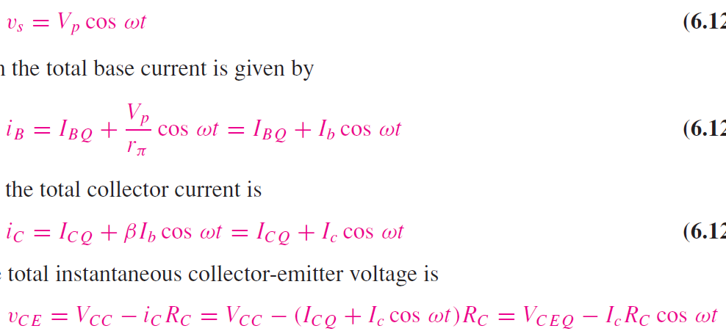
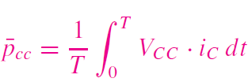
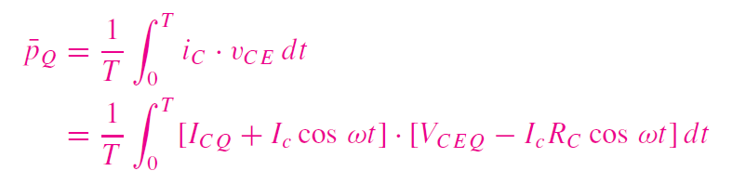
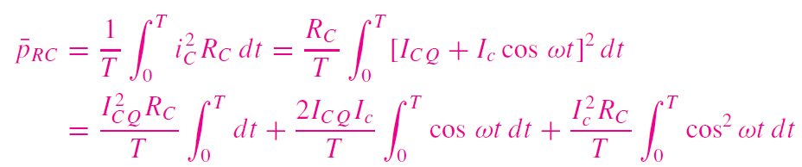
Power in Transistor Amplifiers (v_{s}≠0)
p_{supplied}=p_{dissipated}+p_{transferred to the load}
p_{supplied}= p_{cc}+p_{s} ≈ p_{cc}
p_{cc}>>p_{s}
p_{Q}>>p_{bias}
p_{dissipated}= p_{Q}+p_{bias} ≈ p_{Q}
p_{transferred to the load}= p_{Rc}
p_{cc}≈p_{Q}+p_{Rc}
The next few slides will show how to calculate
DC+AC
4/9/2020

Slide 17


Power in Transistor Amplifiers (v_{s}≠0)
4/9/2020

Slide 18


Power in Transistor Amplifiers (v_{s}≠0)
4/9/2020

Slide 19

Power in Transistor Amplifiers (v_{s}≠0)
4/9/2020

Slide 20
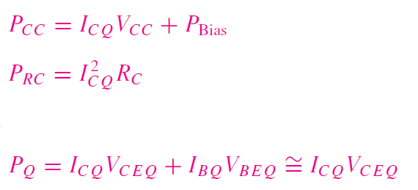
Power in Transistor Amplifiers
v_{s}=0
v_{s}≠0
4/9/2020

Slide 21
Power in Transistor Amplifiers
v_{s}=0
v_{s}≠0
The DC source supplies the same amount of power whether the signal is applied or not
The relative distribution of the supplied power between the load and transistor changes when the input signal is applied
When no signal is applied the transistor dissipates the max power
When signal is applied the transistor transfers a portion of the power supplied from the DC sources to the load, via the input the signal
4/9/2020

Slide 22
Power in Transistor Amplifiers
v_{s}=0
v_{s}≠0
The power rating for a transistor must be higher than the dissipated power when no input signal is applied.
A maximum amount of power is transferred to the load when the amplifier produces the maximum output current.
4/9/2020

Slide 23
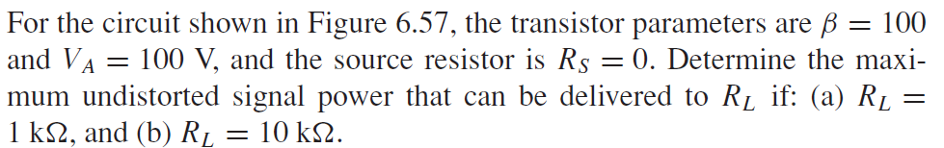
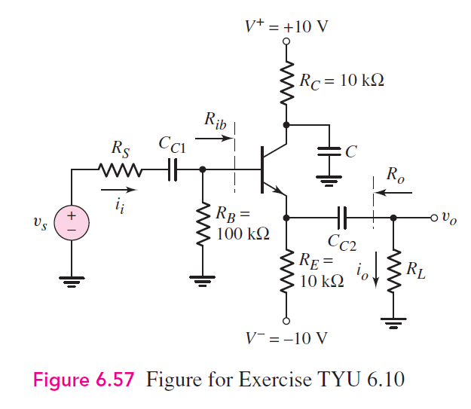
Maximum Undistorted Power-Example
This slide include an example to illustrate the concept of maximum undistorted power
Assume a sinusoidal input signal
*See notes within
lecture 20 folder
4/9/2020

